Slide 1
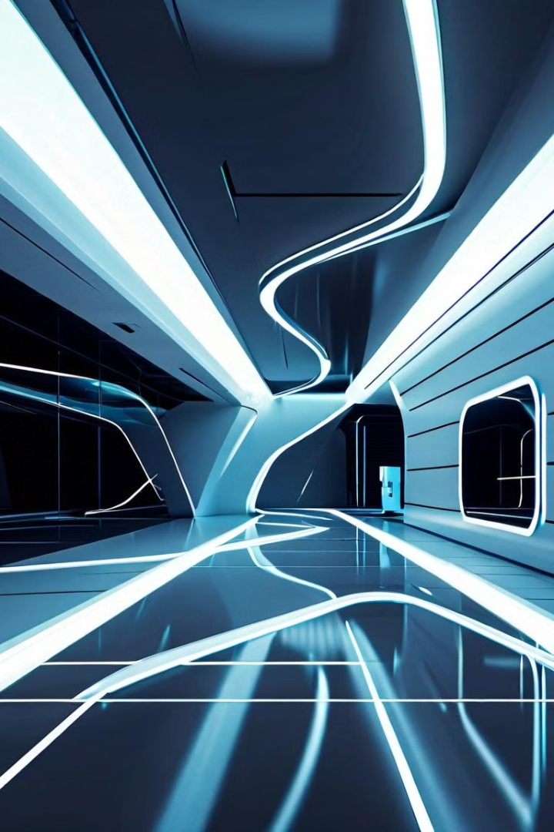
Indoor Localization
Using ML
Group-8
ASHISH ANAND 21051645
PRATIK KUMAR SINGH 21051669
SHUBHAM AGARWAL 21052363
Guided By:-
Dr. Rajdeep Chatterjee
(Associate Professor)
School Of Computer Engineering, KIIT Deemed To Be University

Slide 2

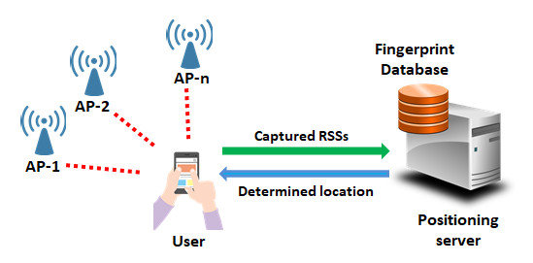
INTRODUCTION
Indoor positioning, also referred to as indoor localization, is the process of determining the location or position of people or objects within indoor environments. GPS (Global Positioning System) is widely used for outdoor positioning, but it becomes less reliable or even unavailable indoors due to signal blockage by buildings and other structures. As a result, indoor positioning technologies have emerged to address the need for accurate positioning within enclosed spaces.
Indoor positioning is important in various industries, including retail, healthcare, and manufacturing. Different technologies such as Wi-Fi, Bluetooth, and RFID are used, but there are challenges such as signal attenuation and privacy concerns. Researchers are continuously working to improve indoor positioning accuracy and reliability.
This introduction provides insight into the evolving landscape of indoor positioning, highlighting its importance across various sectors and the ongoing efforts to enhance its capabilities. As technology advances and new methodologies emerge, indoor positioning is expected to play an increasingly important role in optimizing indoor environments and revolutionizing the way we interact with them.

Slide 3

Challenges of Indoor Navigation
1
Signal Interference
2
Lack of Visual Cues
3
Complex Layouts
Buildings can have intricate floor plans, multiple levels, and dynamic environments, making it challenging to map and track movements accurately.
Walls, floors, and other building structures can disrupt GPS and wireless signals, making it difficult to reliably track locations indoors.
Unlike outdoor environments, indoor spaces often lack recognizable landmarks and visual cues that aid navigation, creating disorientation for users.

Slide 4
Principles of Indoor Localization
Trilateration
Fingerprinting
Dead Reckoning
Determining a device's location by measuring its distance from multiple reference points with known positions.
Creating a database of signal strength measurements at various locations to match a device's wireless signature to its position.
Estimating a device's current position based on a starting point, direction, and distance traveled, using sensors like accelerometers and gyroscopes.

Slide 5




Technologies Enabling Indoor Localization
Wi-Fi
Bluetooth
Computer Vision
Sensor Fusion
Leveraging existing wireless infrastructure to track devices based on signal strength and access point proximity.
Using Bluetooth Low Energy (BLE) beacons to provide accurate, low-power location tracking.
Utilizing cameras and computer vision algorithms to identify and track people and objects within a space.
Combining data from various sensors, such as accelerometers, gyroscopes, and magnetometers, to enhance location accuracy.

Slide 6
Applications of Indoor Localization
Navigation
Asset Tracking
Retail Analytics
Guiding users through complex indoor environments, such as airports, shopping malls, and hospitals, to their desired destinations.
Monitoring the real-time location of valuable equipment, inventory, or personnel within a facility to improve workflow and efficiency.
Analyzing customer movement patterns and dwell times to optimize store layouts, product placements, and marketing strategies.

Slide 7




Improving User Experience with Indoor Localization
Wayfinding
Providing turn-by-turn directions and real-time guidance to help users navigate unfamiliar indoor spaces.
Location-based Services
Delivering relevant information, offers, and personalized experiences based on a user's precise indoor location.
Personalization
Tailoring the indoor experience by recognizing individual users and their preferences, habits, and needs.

Slide 8
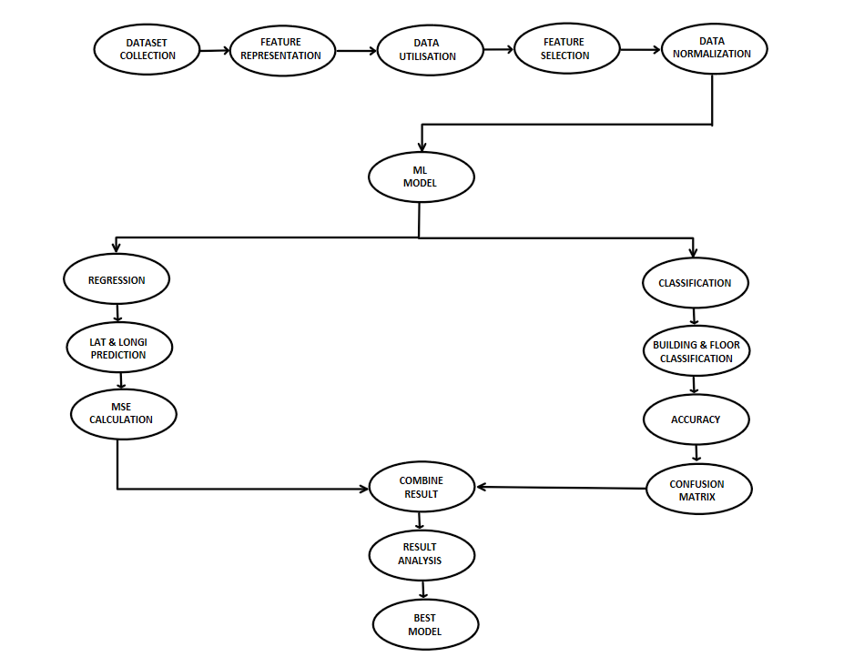
WORKING

Slide 9

Implementing Indoor Localization System
Data collection: The UjiIndoorLoc: An indoor localization dataset was selected for indoor localization because it best suited the needs of our project.
Feature Representation: Different features such as RSSI values from various WAPs, User-IDs, Phone-IDs, Latitude, Longitude, Floor-IDs, Building-IDs, Space-IDs, and Relative Positions were represented.
Data Visualization: All the features are visualized using various graphs and pie charts for better analysis.
Feature Selection: The important features were selected and other irrelevant features were dropped.
Data Normalization: The RSSI values and the Latitude and Longitude were normalized using the MIN-MAX Algorithm.
ML Models: Various Machine Learning models were used for Regression and Classification.
Result: The Mean Squared Error of the Latitude and Longitude was calculated and Classification report was generated for building and floor classification and the confusion matrix was displayed

Slide 10

IMPLEMENTATION
4.1 Methodology OR Proposal
The UjiIndoorLoc: An indoor localization dataset was selected for indoor localization because it best suited the needs of our project. Different features such as RSSI values from various WAPs, UserIDs, PhoneIDs, Latitude, Longitude, FloorIDs, BuildingIDs, SpaceIDs, and Relative Positions were represented. All the features are visualized using various graphs and pie charts for better analysis. The important features were selected and other irrelevant features were dropped. The RSSI values and the Latitude and Longitude were normalized using the MIN-MAX Algorithm.
4.2 Testing OR Verification Plan
Various Machine Learning models were used for Regression and Classification.
REGRESSION:-
SLNO. | ML Models | MSE of Latitude | MSE Longitude
01 | Linear Regression | 8.957931120702725e+16 | 2.2303023073268596e+16
02 | Random Forest | 0.002823285801223364 | 0.0013306212183854106
03 | SVM | 0.004846882951790429 | 0.005550234140687514
04 | KNN | 0.0034299478162809626 | 0.0035724823482214357
05 | Gradient Boost | 0.006387203718657975 | 0.007431012843188413
06 | XG Boost | 0.007104353236283542 | 0.008673913655972837
07 | ADA Boost | 0.02204784986587881 | 0.033680546231124736

Slide 11
CLASSIFICATION OF BUILDING:-
SLNO. | ML Models | Precision | Recall | Accuracy | F1-Score
01 | Logistic Regression | 1.00 | 1.00 | 1.00 | 1.00
02 | Random Forest | 1.00 | 1.00 | 1.00 | 1.00
03 | SVM | 1.00 | 1.00 | 1.00 | 1.00
04 | KNN | 0.99 | 0.99 | 0.99 | 0.99
05 | Gradient Boost | 1.00 | 1.00 | 1.00 | 1.00
06 | XG Boost | 1.00 | 1.00 | 1.00 | 1.00
07 | ADA Boost | 0.98 | 0.99 | 0.99 | 0.99
08 | Guass Naive Bayes | 1.00 | 1.00 | 1.00 | 1.00
CLASSIFICATION OF FLOOR :-
SLNO. | ML Models | Precision | Recall | Accuracy | F1-Score
01 | Logistic Regression | 0.88 | 0.88 | 0.88 | 0.88
02 | Random Forest | 0.92 | 0.91 | 0.91 | 0.91
03 | SVM | 0.90 | 0.90 | 0.90 | 0.90
04 | KNN | 0.85 | 0.82 | 0.83 | 0.82
05 | Gradient Boost | 0.91 | 0.91 | 0.90 | 0.90
06 | XG Boost | 0.92 | 0.91 | 0.91 | 0.91
07 | ADA Boost | 0.50 | 0.58 | 0.52 | 0.58
08 | Guass Naive Bayes | 0.49 | 0.41 | 0.41 | 0.41

Slide 12

CONCLUSION
Machine learning (ML) has great potential to transform navigation and spatial awareness in enclosed spaces when used in indoor localization projects. These projects provide advanced methods for precisely locating objects or people inside buildings by combining various machine-learning algorithms and approaches. With the use of data gathered from several sources, including Bluetooth beacons, Wi-Fi signals, and sensor data, machine learning algorithms can efficiently identify patterns and correlations that facilitate accurate localization. Moreover, ML adoption makes it easier for localization systems to be continuously improved and adjusted, guaranteeing reliable performance in dynamic indoor environments. Therefore, ML-powered indoor localization projects not only improve user experiences but also open up new application avenues for many industries, ushering in a new era of indoor navigation and spatial intelligence.

Slide 13
Future Trends and Opportunities
5G and Cellular Networks
Augmented Reality
The rise of 5G and advanced cellular technologies will enhance indoor localization accuracy and coverage.
Integrating indoor localization with AR will enable seamless, immersive navigation and information overlays.
Internet of Things (IoT)
Privacy and Security
The proliferation of IoT devices will provide a wealth of sensor data to further improve indoor tracking and analytics.
Addressing user privacy concerns and ensuring secure data handling will be crucial for widespread adoption.

Slide 14
REFERENCES
[1] The UjiIndoorLoc : An indoor localization dataset
Link: https://www.kaggle.com/datasets/giantuji/UjiIndoorLoc
[2] Github: Indoor-Positioning-using-WiFi-Machine-Learning-for-Industry-5.0
Link: https://github.com/drtiwari/Indoor-Positioning-using-WiFi-Machine-Learning-for-Industry-5.0
[3] Research Paper:
Link: https://www.researchgate.net/publication/350579120_Machine_Learning_Based_Indoor_Localization_using_Wi-Fi_and_Smartphone?enrichId=rgreq-39daf2e8f672439631b37c14b7a528a7-XXX&enrichSource=Y292ZXJQYWdlOzM1MDU3OTEyMDtBUzoxMDQ2MTA3MDIyOTcwODgwQDE2MjY0MjI3NTgxMTQ%3D&el=1_x_2&_esc=publicationCoverPdf

Slide 15

THANK YOU

